Slide 1


Exploration of Numerical Precision in Deep Neural Networks
Zhaoqi Li, Yu Ma, Catalina Vajiac, Yunkai Zhang
Industry Mentors: Nicholas Malaya, Allen Rush
Academic Mentor: Hangjie Ji
Research in Industrial Projects for Students (RIPS) 2017
Notes:
Introduce IPAM here
For people that don’t know us, we belong to the Research in Industrial Projects for Students program and work at UCLA, and our research is co-sponsored by both IPAM and AMD.

Slide 2
About RIPS
Research in Industrial Projects for Students (RIPS)
Conducted through Institute of Pure and Applied Mathematics (IPAM) at UCLA
Nine projects, each sponsored by a different company
Notes:
Fun experience

Slide 3
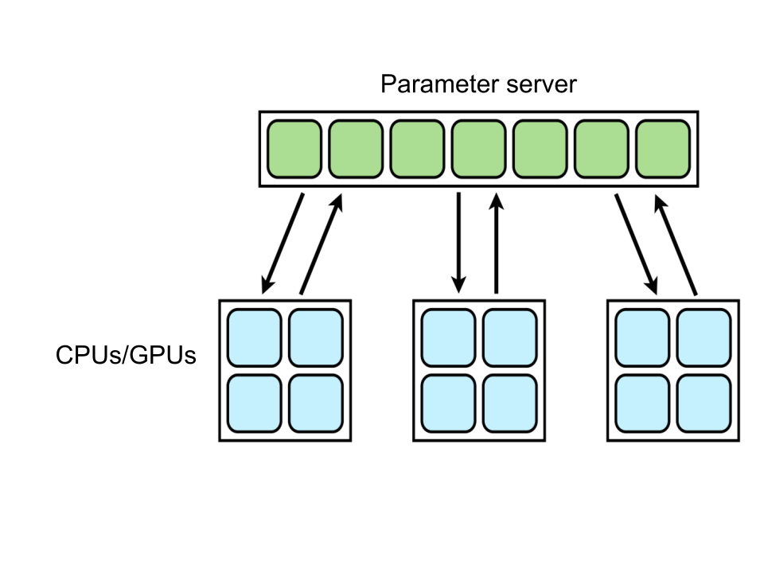
Motivation for Reduced Precision
Reduces time and space required for computation
Memory-bound or compute-bound systems
e.g. CPUs, GPUs, mobile devices
Distributed ML Algorithms
Reduced precision => reduced message size
Deep Neural Networks (DNNs):
Computationally expensive
Exhibit natural resilience to errors
Notes:
Solves the question: why do we care about reduced precision? THIS SLIDE SHOULD SOLVE THE QUESTION: WHY REDUCED PRECISION IS USEFUL?
Note: compute-bound: the time for it to complete a task is determined principally by the speed of the CPU. This is what Nick mentioned in an email pre-midterm presentations
Reduce precision -> reduce data needs to be stored
- For mobile devices, which have limited amount of memory, by reducing data we can store more info
- For GPU, we can reduce the amount of data transferring between machines, thus good for performing small tasks in parallel
- For distributed algorithms, where many machines interact with parameter server, less precision means that less bits to be transferred between machines - fast the alg
DL: multiple machine runs on the same network -> needs communication -> …

Slide 4
Previous Work
Train with 16-bit and stochastic rounding (Gupta, et al. 2015)
Train with low-precision multiplications (Courbariaux, et al. 2014)
Train with binary weights (Courbariaux, et al. 2015)
One-bit gradient for parallelization of SGD (Seide, et al. 2014)
Notes:
Per-layer reduced precision error tolerance (Judd, et al. 2016)
Add results of each paper
Gupta: Deep Learning with Limited Numerical Precision
Use stochastic rounding
MNIST and CIFAR10

Slide 5
However...
No previous work capable of predicting sensitivity to precision
No estimate of precision tolerance established
No previous study on exactly how bit size affects neural network
only an approximate analysis on CNN’s resiliency to approximation error in general
Notes:
Note: say that we will define arbitrary precision later

Slide 6
Workflow
Start
Gain understanding of DNNs and numerical precision
Implementation of arbitrary precision
Estimate precision bounds for particular networks
What affects training accuracy?
Conduct error analysis
End
Ongoing Results and Future Work
Plot params of interest against bit-size
Notes:
Make flowchart?
https://en.wikipedia.org/wiki/Flowchart

Slide 7
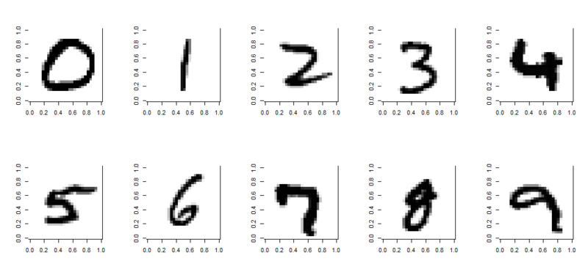
MNIST Dataset
Digit recognition (Classification Problem)
28x28 pixel, grayscale
Input: 60,000 images for training 10,000 images for testing
Output: 10-element vector
Simple ML dataset
1 iteration = go through the entire dataset once with mini-batch
Takes less than 50 iterations to converge
Usually get to over 95% accuracy

Slide 8
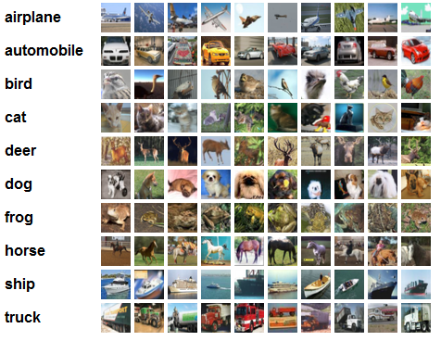
CIFAR-10 Dataset
Object classification
32x32 pixel, colored
Input: 60,000 images for training 10,000 images for testing
Output: 10-element vector
More complex than MNIST
Needs higher precision
~80%: good
Notes:
Stanford demo: ~80%

Slide 9
Software
Need framework in order to experiment with precision
Common frameworks:
Tensorflow: too many basic operations per function
CAFFE: only supports float-32 by default
Theano: less “black-boxed” than Tensorflow
Notes:
Think about transition between dataset and software

Slide 10
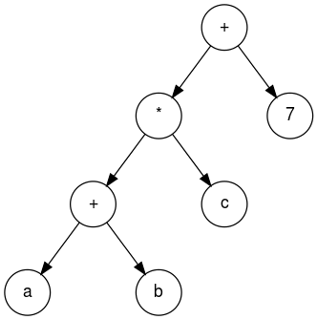
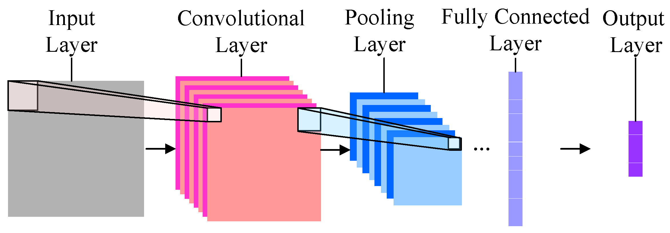
Different Truncation Methods
Truncation by elementary operation
Future work
Truncation by layer
Currently used method
Truncation by batch
Currently used method

Slide 11
Arbitrary Precision: Introduction
Goal: be able to explore low precision on a continuous scale
To implement:
Create filter
Bitwise AND with original number
0 0111 1111 1111 1100 1100 1100 1100 110 1.98749995
&
1 1111 1111 1111 1110 0000 0000 0000 000 16-bit filter
----------------------------------------
0 0111 1111 1111 1100 0000 0000 0000 000 1.984375
Notes:
Catalina explained why and when to truncate, and now i will talk about how to implement reduced precision. Normally, people use bits with multiples of 2 to represent a number, like 32 bits, 64 bits, or 16 bits. But sometimes if 32 bits is sufficient to train a network, why don’t we try 24 bits, or even 20 bits? This is when arbitrary precision comes into play, where low precision is represented on a continuous scale.
Suppose we want to truncate this number, 1.98749995, into 16 bits. First, we will create a 16-bit filter with all 1s for the first 16 bits and all zeros for the next 16 bits. After applying the & operation, the first 16 bits will remain the same, while the last 16 bits will become all zeros. The resulting 1.984375 is the 16 bit representation of the number.

Slide 12
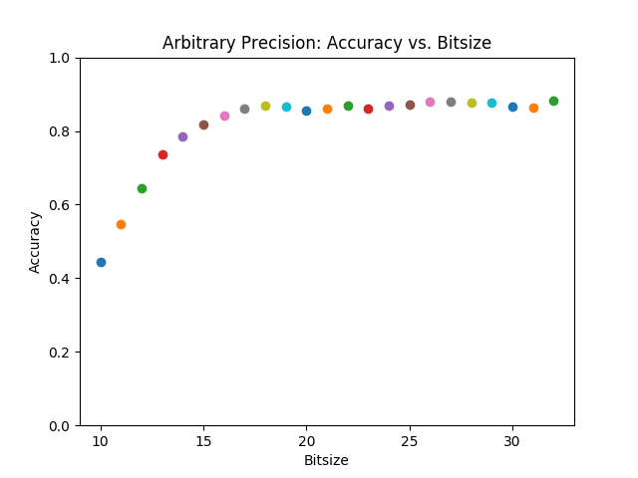
Arbitrary Precision: Logistic Regression Results
y = Wx + b
Applied to MNIST
Accuracy after running logistic regression for 1000 iterations
Avg. of 30 trials per bitsize
Notes:
So here we tested different arbitrary precisions on a simple logistic regression example for MNIST. By logistic regression, I just mean the model y = Wx + b. The results are plotted here on the left, with x-axis showing the various bit sizes and y-axis showing the corresponding accuracies. As you can see, arbitrary precisions above 16 bits are able to achieve similar accuracies, but it starts to drop below 16 bits. This turning point is exactly we want to find. We want to determine the smallest amount of bit sizes to use such that the network could just maintain sufficient accuracy.

Slide 13
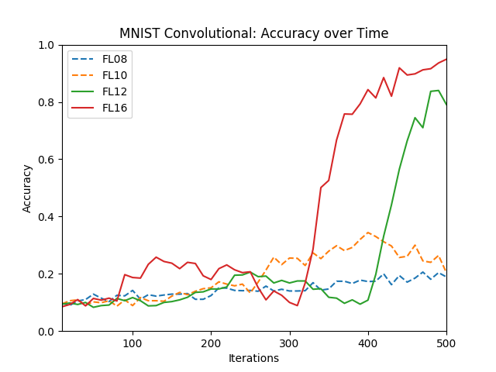
Arbitrary Precision: CNN Results
More complicated than logistic regression
Accuracy vs. iterations
One trial per bitsize
12 bits: inflection point
Notes:
But logistic regression is way too simple. To test reduced precision on a more complicated case, we decided to apply convolution neural network to the same example. This time the plot shows iterations vs accuracy instead of bitsize. Unlike logistic regression, even with 12 bits CNN can still get to a fair level of accuracy. This means that different networks may be trained with different levels of precisions. But how do we know for any given network, what the required amount of precision will be? Or rather, how do we generalize our result to different networks?

Slide 14
How to generalize the results?
Start with one simple architecture
Change some parameters
Does reduced precision still work?
Big question: what parameters are more sensitive to reduced precision?
Notes:
We will start with one simple architecture, change some of the parameters, and then see the new network still works with the new precision. Eventually, we want to see what parameters are more sensitive to reduced precision and what are their relationships?

Slide 15
Current Architecture
Input - 2x convolution/pooling - dense - softmax - output
Initial weights: small random numbers; mini-batch: 128; activation: ReLu
Reason:
Fast runtime
Parameters can be easily changed
Convenient to feed in different datasets
Data analysis:
Final accuracy
Convergence speed
x2
x2
Notes:
The architecture we decided to use is a common network for image processing. It is a convolutional neural network with 2 convolution and pooling layers followed by a dense layer. Then softmax is applied to get the final output. Weights are initialized to be small random numbers. The batch size is 128 and ReLu is our activation function. We chose this network mainly because its fast runtime, so we can easily test more parameters before moving on to more complicated networks. It also supports both MNIST and CIFAR10 that we are going to experiment with. But how do we decide if a network is performing well? We will first look at its final accuracy, and if it converges to a high level we will then look at how fast it converges.

Slide 16
Exploration of Parameters of Interest
Rounding scheme (stochastic/deterministic)
Number of dense layers
Number of units in dense layer
Batch size
Initial weight conditions
Notes:
We explored the following parameters to see its accuracy and convergence speed on our neural network

Slide 17
Truncation vs. Stochastic Rounding
Two methods to implement reduced precision
Truncation: always rounding down
Stochastic rounding:
Rounding x to ⌊x⌋ + ε is proportional to how close x is to ⌊x⌋ + ε
Unbiased rounding scheme
Trends using stochastic rounding:
Some cases converge vs. not converging with truncation
↑ speed of convergence
Notes:
Unbiased rounding scheme : if we truncate we always have numbers that are smaller
But SR, since sometimes you round up/down, the average truncation error is zero

Slide 18
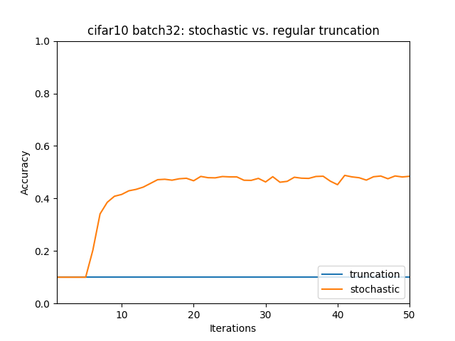
Truncation vs. Stochastic Rounding: Results
Notes:
50 iterations, using float32, this happens for some batch sizes but not others
Something to look into in future weeks?
Sometimes SR works/converges and sometimes never
Look into why sometimes it works
Might be caused by the random weight which was not fixed

Slide 19
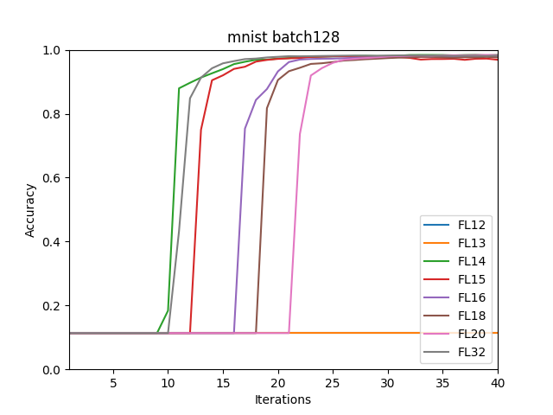
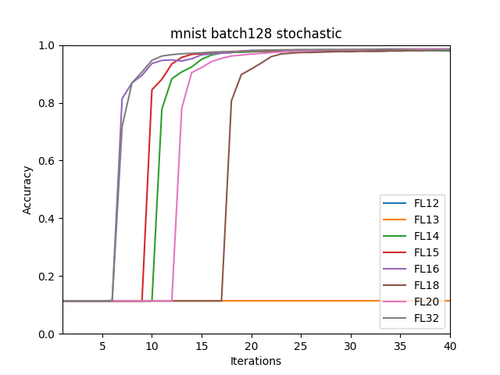
Truncation vs. Stochastic Rounding: Results
On average, stochastic rounding improves speed of convergence by 25%
Notes:
Level of accuracy doesn’t change - hypo: learning rate too large
How quickly it converges does

Slide 20
Number of Dense Layers
Attempted one to five dense layers with 100 units per layer
Difference between number of dense layers (at all bit size)
number of dense layers ↑, convergence speed ↓
number of dense layers ↑, final accuracy ↓
number of dense layers ↑, fluctuations during convergence ↑
May caused by accumulation of error
Notes:
We will show using the following plots to show that
Another very important parameter which we investigated the number of layer, here we specifically discuss the number of dense layers. Dense layers allow us to effectively control confounding parameters such as filter size and pooling size and made our results much more reliable.we attempted one to five dense layers, with a uniform 100 units per dense layer. The results show that …

Slide 21
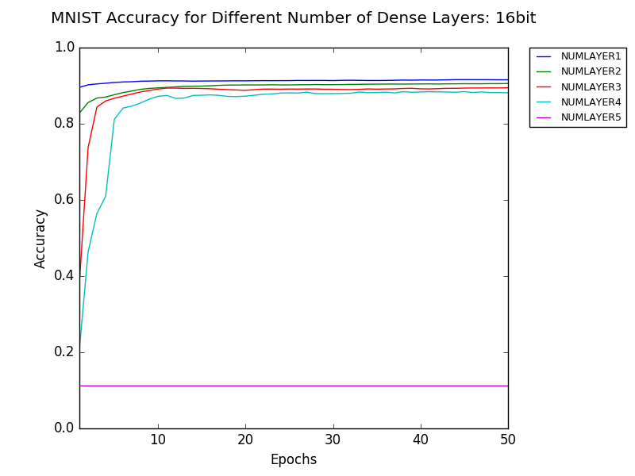
Number of Dense Layers: Results
Notes:
Here we see that though 1-4 dense layers all converge, the higher # of dense layers, the lower the accuracy. And for five layers, it does not converge at all. However, when we increase the bit size by just two, not only did five layer converges, but it achieves very decent result regardless of the fluctuations when approaching convergence.

Slide 22
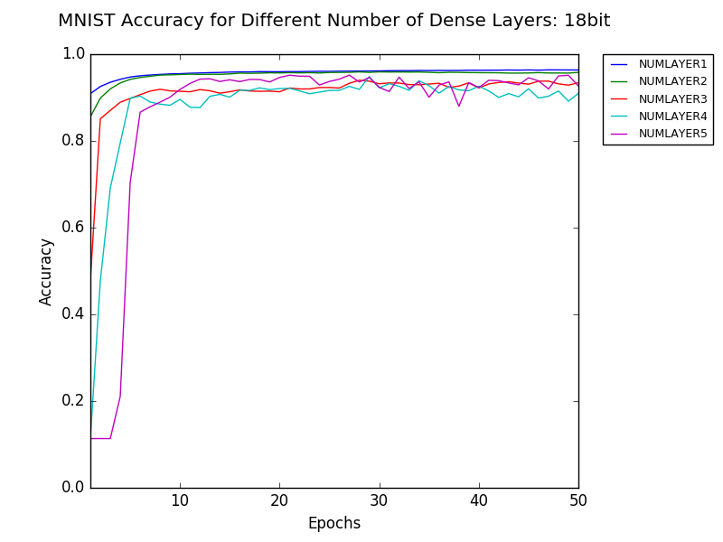
Number of Dense Layers: Results
Notes:
Here we see that though 1-4 dense layers all converge, the higher # of dense layers, the lower the accuracy. And for five layers, it does not converge at all. However, when we increase the bit size by just two, not only did five layer converges, but it achieves very decent result regardless of the fluctuations when approaching convergence.

Slide 23
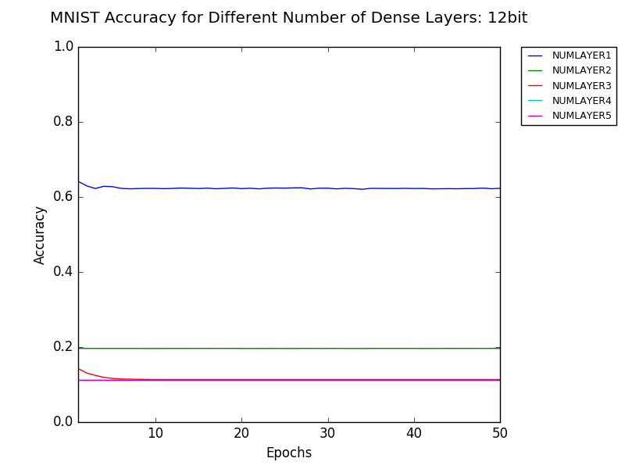
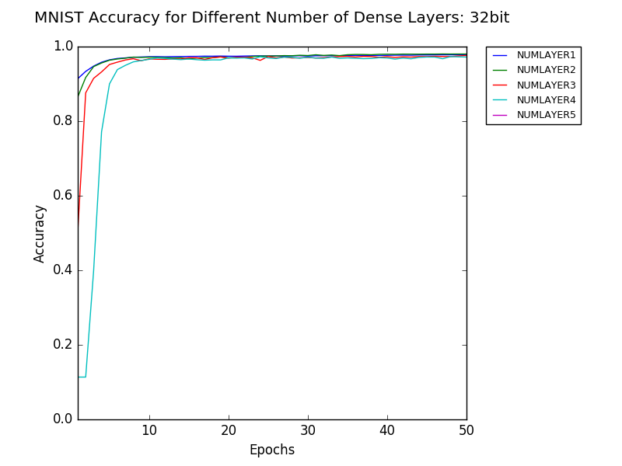
Number of Dense Layers: Results
Low precision has significant influence when number of layers ↑
Notes:
These show that the number of bit size significantly contributes the convergence behavior of neural network when number of layers increase. This is especially applicable to deep learning since the main idea is to have a large number of layers.

Slide 24
Number of Dense Units
A two convolutional layer and one dense layer structure
Tested 160, 130, 110, 100, 90, 70 and 40 units per dense layer
Difference between number of dense units
In general, a random final accuracy distribution with respect to bit size
16 bit: number of dense units ↑, final accuracy ↑
Notes:
More dense unit more memory

Slide 25
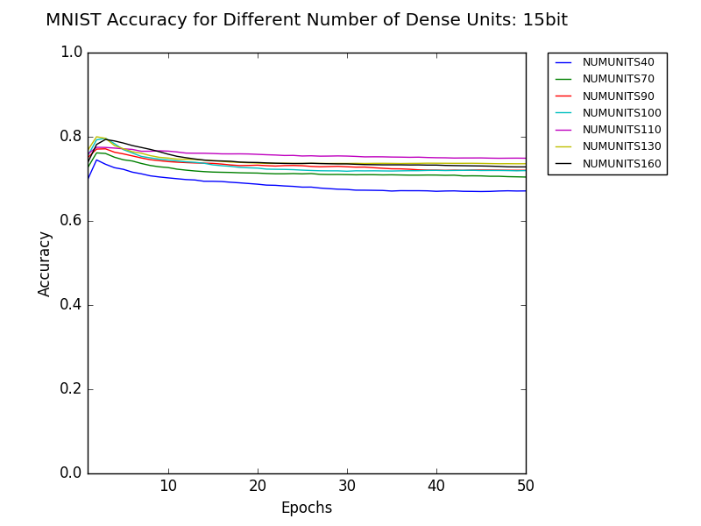
Number of Dense Units - Results

Slide 26
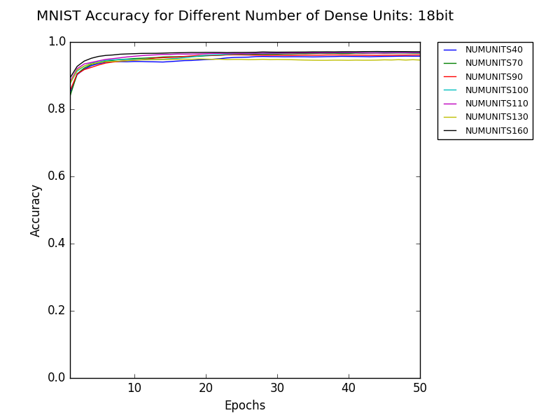
Number of Dense Units - Results

Slide 27
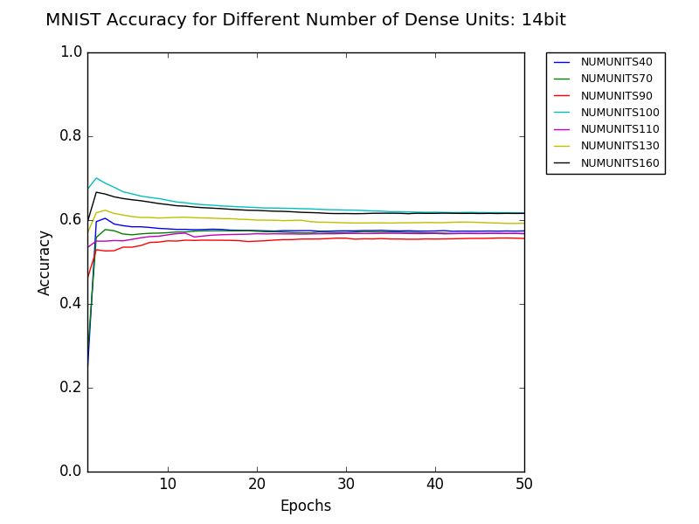
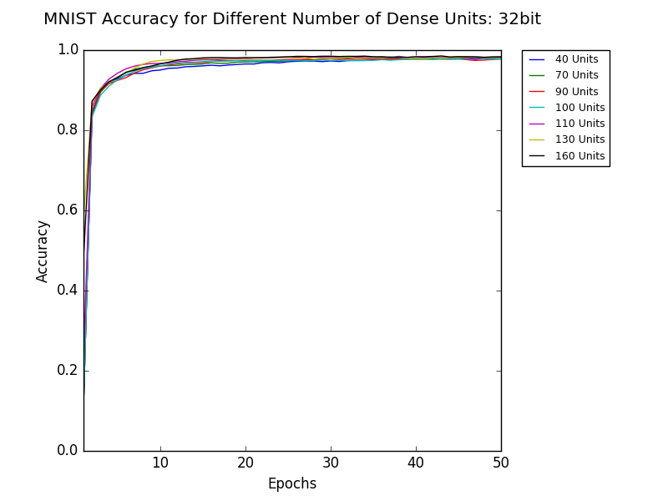
Number of Dense Units - Result Summary
Optimum at low precision may not require high number of dense units
Notes:
This show that there is a random behavior between num of bit sizes and the optimal num of dense unit to achieve the best performance. This could be very significant in the future as the most optimal point may not require the highest num of dense unit when in low precision. There is a possibility to optimize the two in order to achieve some great yet much more memory efficient implementation.

Slide 28
Batch Size: Introduction
Number of samples to propagate through algorithm at a time (mini-batch)
32, 64, 128, 256, 512
Requires less memory and typically reduces runtime vs. full batch
Eliminates random data variations vs. stochastic gradient descent
Difference between batch sizes
Level of accuracy: unaffected
↓ batch size, ↑ speed of convergence

Slide 29
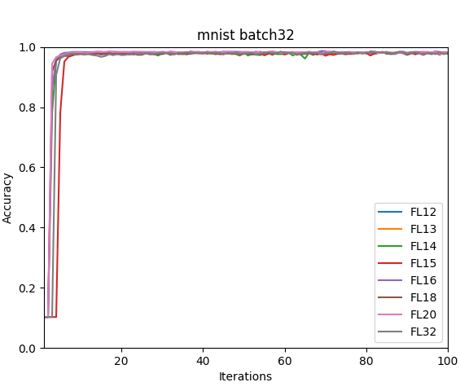
Batch Size: Results

Slide 30
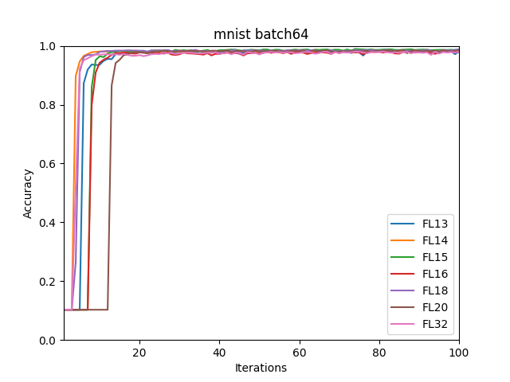
Batch Size: Results

Slide 31
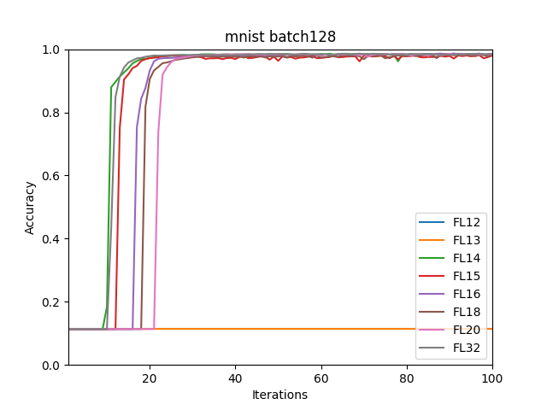
Batch Size: Results

Slide 32
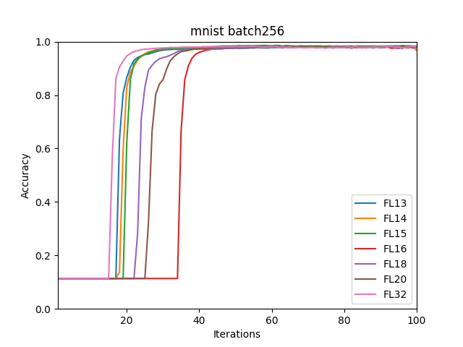
Batch Size: Results

Slide 33
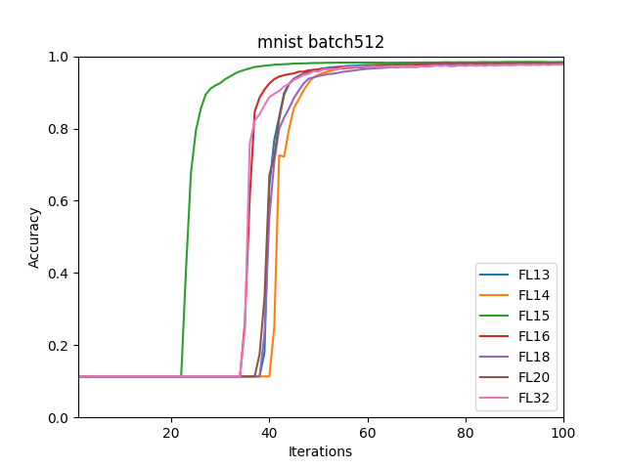
Batch Size: Results
Convergence speed goes down as batch size increases

Slide 34
Perturbation to Initial Weights
Weight initialization affects final accuracy (Stanford CS231n)
Positive initial weights: 80%
Random initial weights to break the symmetry
Show that CNN is sensitive to input weights
Reduced precision have a direct impact on CNN
Notes:
80% uniform only converge up to 80
Recall we consider 95 is good, so this is not working
So why?
Reason is uniform gives a lot of symmetry to each neurons so during training process each neuron learn similar things
So we use random
In terms of both training accuracy and time
t is known that weight init … accuracy, so we wanna test if it’s sensitive to reduced precision.
Not good - 95% good accuracy
Small perturbation can cause decrease in accuracy, and a longer time to train
CNN sensitive to inputs - SCARY! Because when we reduce precision, we are actually perturbing the initial weight by truncating the numbers down a little bit, and thus reduced precision will thus have an impact

Slide 35
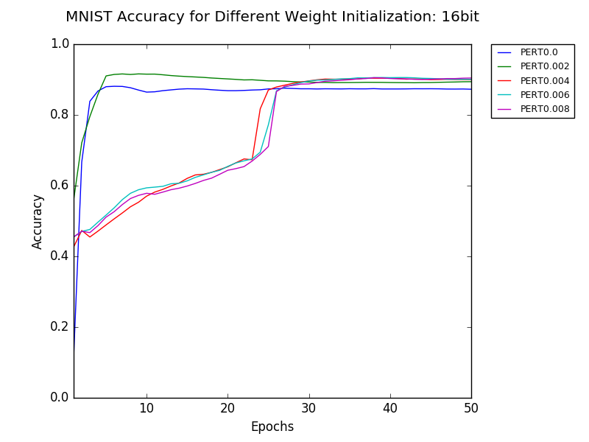
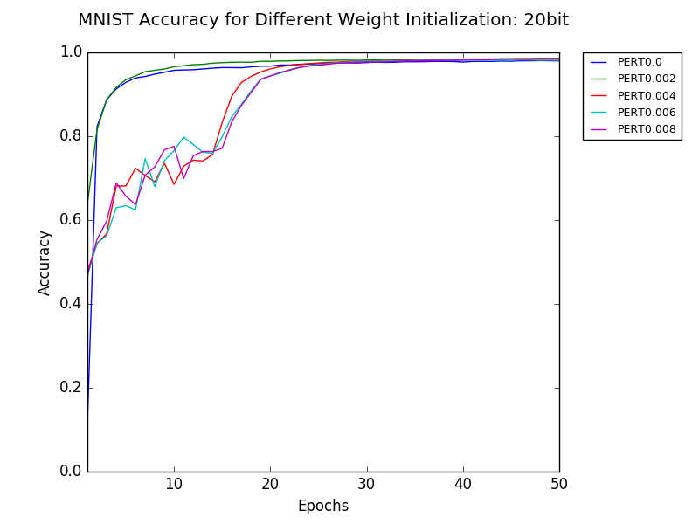
Weight Initialization - Results
Sensitive to weight initialization in both accuracy and training time
Notes:
Use default setting - 2 conv. 1 dense
Everything does converge - 0.004-0.008 converges slower & fluctuation
Is sensitive to the input, while test results on a more complex dataset (like Cifar-10) will demonstrate more significance (say, if it converges at all)

Slide 36
Summary
Reduced precision affects accuracy:
As number of layers goes up
As number of dense units changes
Affects both accuracy and training time as initial weight changes
Reduced precision affects time, while not accuracy:
Stochastic rounding speeds up convergence by 25%
Larger batch sizes take longer to converge
Notes:
So we’ve explained lots of params. As a recap,

Slide 37
Error Analysis
Recall the structure of convolutional neural network:
Input Convolution Pooling … Output
Question: how does the error accumulate during forward and backward propagations?
Traditional truncation method
Rounding method
Notes:
Now that we’ve had those results for training accuracy, we’d like to have some theoretical investigation of the accumulation error.

Slide 38
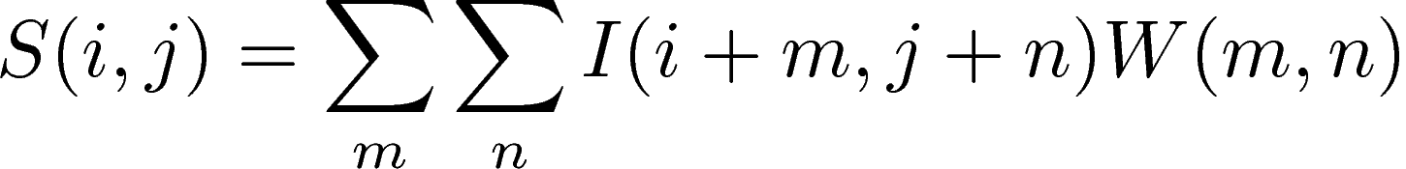

Error Analysis: Forward Propagation
Convolution: use a discretized version
Assuming that , equivalently,
Notes:
Use a discretized version, which is what’s implemented in the computer.
The order of I is the same as that of W
\varepsilon: representation of the round-off error
since truncation always rounds down, the approximation is less than the true value, which is why we put “-” sign in this equation

Slide 39
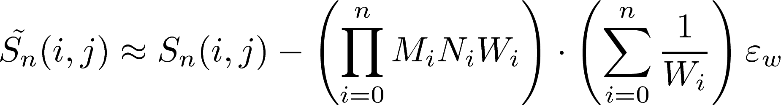
Error Analysis: Forward Propagation
An error estimate for the forward propagation:
⇒ Linear scaling of error with dimension of weight matrices
Notes:
Conclusion: scales with dimensions of weight matrices
Not scaling with # layers based on preliminary analysis -> interesting and counter-intuitive

Slide 40
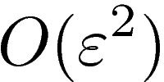
Error Analysis: Back Propagation
Similar method to forward propagation
Requires computing the gradients and using chain rule
No regularization, squared error measure, Sigmoid activation function
Last layer: scales with depending on output and weights
Complicated to predict the dependency on previous layers
Notes:
Backpropagation is used during training process, and it serves to update the weights.
Requires computing the gradient of cost function wrt each weight, and bias variable -> makes it more complicated
To compute the gradient of the cost function wrt weight in previous layers, we use chain rule to get these grads
As for analysis, use similar methods like set an \eps and see how it accumulates with ops

Slide 41
Error Analysis: Back Propagation
Similar method to forward propagation
Requires computing the gradients and using chain rule
No regularization, squared error measure, Sigmoid activation function
Last layer: scales with depending on output and weights
Complicated to predict the dependency on previous layers
Conclusion: Forward propagation is dominating the sensitivity
Notes:
The reason why we see back propagation causes the error might be that it’s “the straw that broke the camel's back”.

Slide 42
Conclusion
Implement arbitrary precision and test on MNIST
Explore sensitivity of convolutional neural networks
Accuracy is sensitive to: weight initialization, dense units, # of dense layers
Time is sensitive to: rounding scheme, batch size
Demonstrate error analysis using truncation method

Slide 43
Ongoing Effort
Truncation by layer
Truncation by operation
Verify conclusions on more advanced architectures
More variations of error analysis
Notes:
Say, analyze the error bound for rounding methods, or even for stochastic rounding methods, which is more commonly implemented in recent neural networks
Lots of our conclusions are based on MNIST or Cifar-10, which are relatively simple networks; and our neural network architecture has only two conv layers and one dense layer; will be good to test more complex datasets & nnets
Currently, truncation by batch; still lots of operation that uses high precision, say, convolution & pooling; to get a result closer to what’s actually happening for lower precision, trunc by layer & operation is useful

Slide 44
Acknowledgement
This research was carried out as part of the 2017 RIPS program at the University of California, Los Angeles, and was supported by NSF grant DMS-0931852.
The authors would like to thank Nicholas Malaya, Allen Rush, Hangjie Ji for their mentorship, support, and valuable advice. The authors would also like to thank Dimi Mavalski and Susana Serna for their help on organizing the RIPS program.
The authors thank AMD Company for their sponsorship and support.

Slide 45
Thank you for your attention!
Questions?
Zhaoqi Li: zli@macalester.edu
Yu Ma: midsummer@berkeley.edu
Catalina Vajiac: cvajiac01@saintmarys.edu
Yunkai Zhang: zhang.yunkai98@gmail.com
Notes:
For Q&A, one person answers each question - whoever said first answers this, unless he/she doesn’t know what to say -> try not to interrupt others’ answer, even if it’s wrong

Slide 46
References
[1] Gupta, Suyog, et al. “Deep Learning with Limited Numerical Precision." ICML. 2015.
[2] Goodfellow, Ian, Yoshua Bengio, and Aaron Courville. Deep learning. MIT press, 2016.
[3] Courbariaux, Matthieu, Yoshua Bengio, and Jean-Pierre David. "Training deep neural networks with low precision multiplications." arXiv preprint arXiv:1412.7024 (2014).

Slide 47
Mixed Precision
Change precision after a certain number of iterations
Could happen multiple times per several epochs/batches
Current direction: low to high
High precision to low precision
Notes:
Another method which we experimented with was mixed precision, where we achieved the goal of reducing precision by changing precision after a certain number of iterations. This process could happen multiple times as (?) we repeat it per batch or per layer. The current direction of precision goes from high to low, where we attempted and investigated the results of float64 to float32, float32 to float16. The result shows that float64 to float32 exhibit very similar accuracy with the optimal accuracy. While float32 to float16 demonstrates a significant accuracy decline.

Slide 48
Number of Convolutional Layers: Conclusion
One to five convolutional layers with one dense layer
Controlled previous layers’ dimensions when adding new layers
Difference between number of conv. layers
One layer converges faster at all bit size
One layer has lower final accuracy at low bit size
Three and above do not converge at all for all bit size
18bit - the threshold for convergence
Notes:
Was not able to control filter size and pooling size because of dimension error

Slide 49
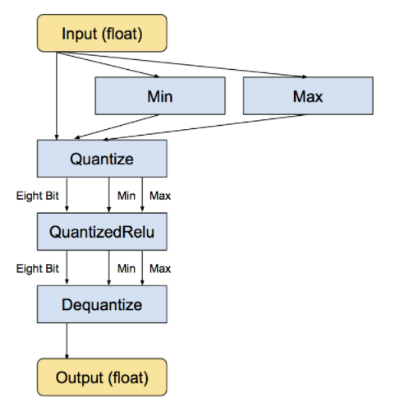
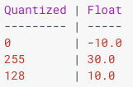
Quantization
Theano and Lasagne based code by Matthieu Courbariaux
Binary Net (quantize to -1 and 1)
Benchmark performance on MNIST, CIFAR-10 and SVHN
8-bit CNN
Quantize input, weight, and output gradient
Difficult to customize arbitrary uint datatype
Notes:
The last method we experimented with was quantization. The idea behind it is that, since we know almost all of the space taken up by neural network is consist of the weights for neural connections, we could shrink the file sizes by storing the min and max for each layer of the network, and then compress each weight value, which is a float number, to an n-bit integer representing the closest real number in a linear set of 2^n within that range. The picture here shows the quantization process within a layer. We first select the min and max of the input float numbers, and then quantize these numbers to, in this case, 8-bit integers and run them through every similarly quantized operation such as the activation Relu function. At the end, we return them back to float values as output.
The two methods of quantization we investigated were binarynet and 8-bit integer representation, both of which were invented by Matthieu Courbariaux. binaryNet is a more extreme version of quantization, where the quantized values were restricted to only -1 and 1. Though surprisingly simple, it achieved benchmark performance on MNIST, CIFAR-10 and SVHN according to literature. However, we were a bit sceptical of its general application to other tasks other than image classification, and thus did not proceeded investigating it in depth. The 8-bit CNN version quantized the input, weight and output gradient for each layer to N-bit integers, where N was determined by numpy datatype uint8,16,32, and 64. It achieved a 99.07% accuracy for the MNIST dataset and was the main thing we experimented with.
(0.96% 2.80% 11.40% )

Slide 50
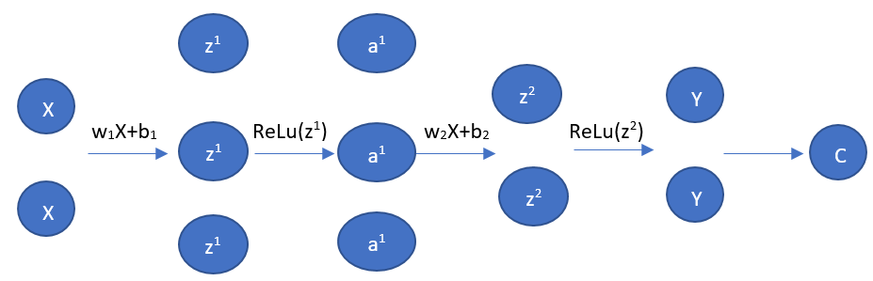
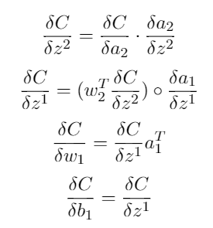
4. Truncation by layer
Cannot truncate directly -> one line does all numerical computations
Alternative: Chain rule
Example: one hidden layer

Slide 51
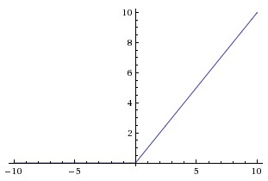
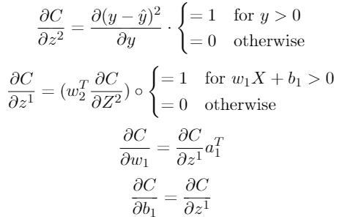
Cost = Squared Error
Values:
ReLu

Slide 52
5. Truncation by operation
Implementation:
Hard to be done with Theano: too many basic operations within theano.function
Use sympy to represent equations in tree structure
Recursively iterate through tree and truncate after each basic operation

Slide 53
Notation
Representation error: ε
I: input data
W: weight matrix
S: output

Slide 54


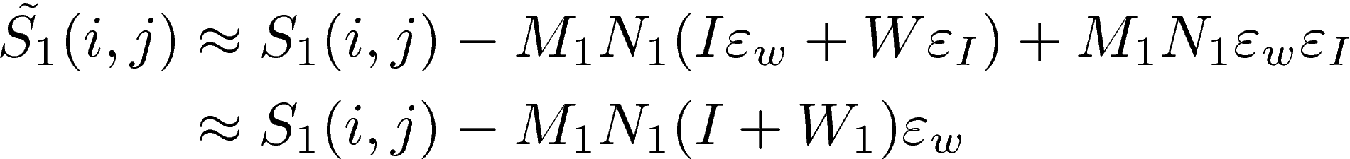
Error Analysis: Forward Propagation
Assuming that weight matrix has dimension

Slide 55
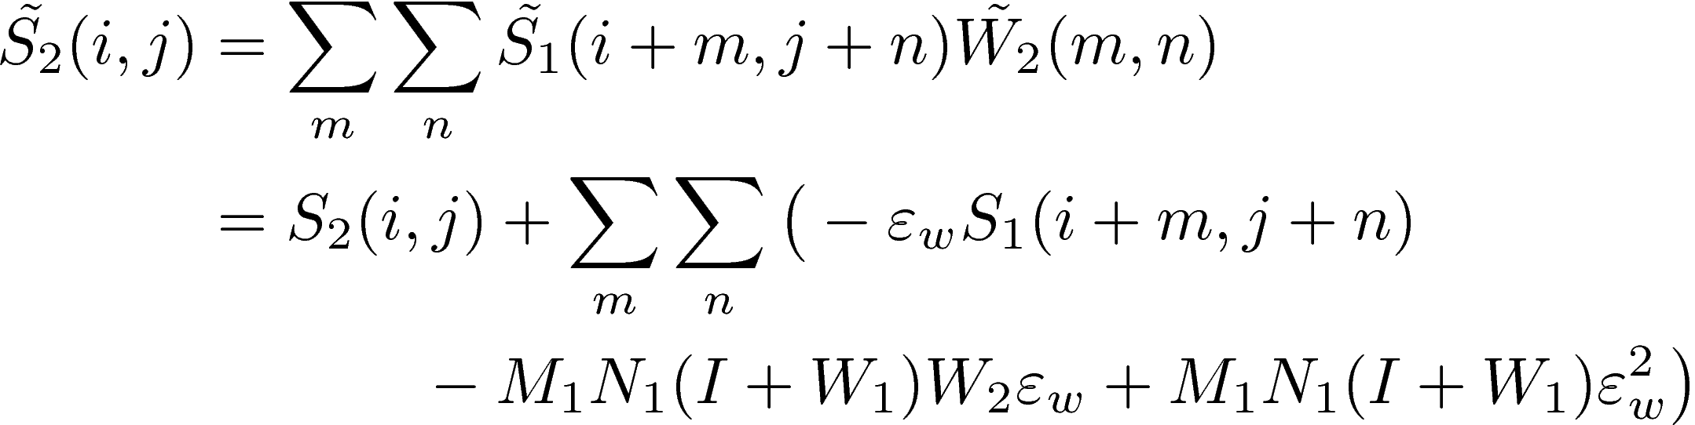

Error Analysis: Forward Propagation
Similarly, for the second layer,
Approximating as

Slide 56
More variations of error analysis
Stochastic rounding instead of truncation
Error term will be a distribution
Truncation by layer/batch instead of by elementary operation
To validate our current conclusions
More than one error terms

Slide 57
Previous Work: Google TPU
Quantization: use an 8-bit integer to approximate an arbitrary value between preset min & max values
Pros:
Reduces hardware footprint and energy consumption
TPUs: 65,536 8-bit integer multipliers
GPUs: few thousands of 32-bit floating-point multipliers
Cons:
Some networks are too sensitive for this, can diminish accuracy
Notes:
Being able to use integer rather than floating point operations greatly reduces the hardware footprint and energy consumption of our TPU. A TPU contains 65,536 8-bit integer multipliers. The popular GPUs used widely on the cloud environment contains a few thousands of 32-bit floating-point multipliers.

